Slide 1
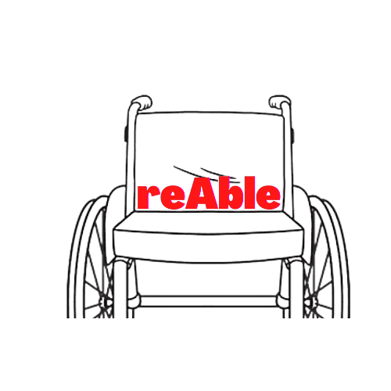
UNDERSTANDING
AUDITORY DISABILITY
Presented by
reAble

Slide 2
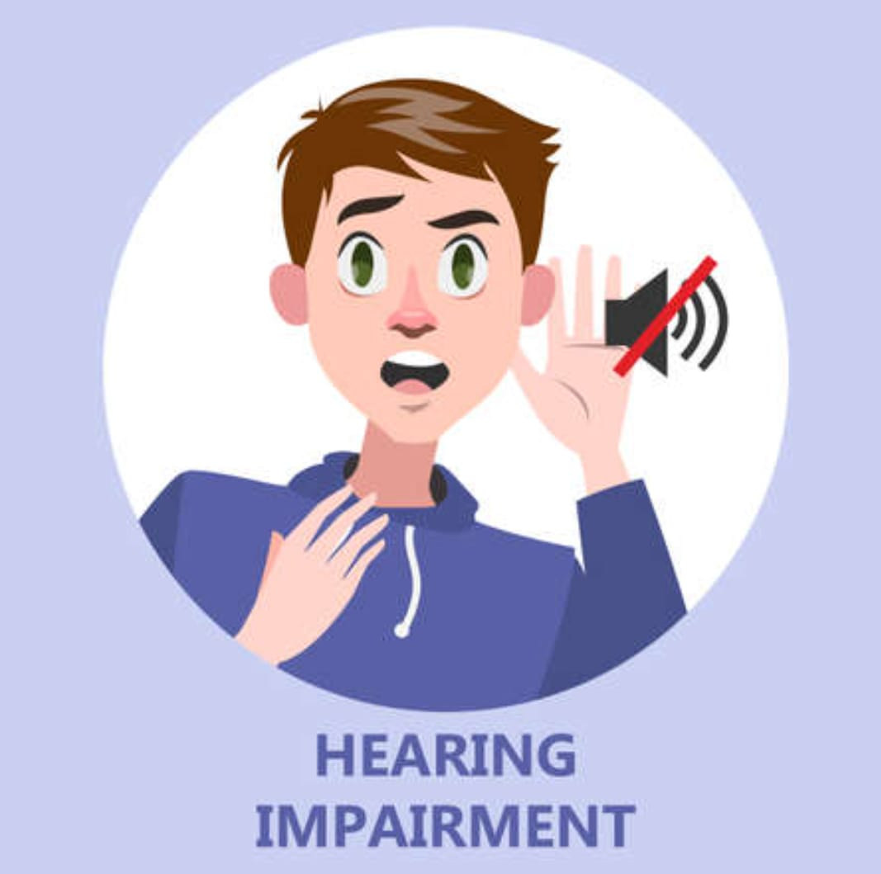
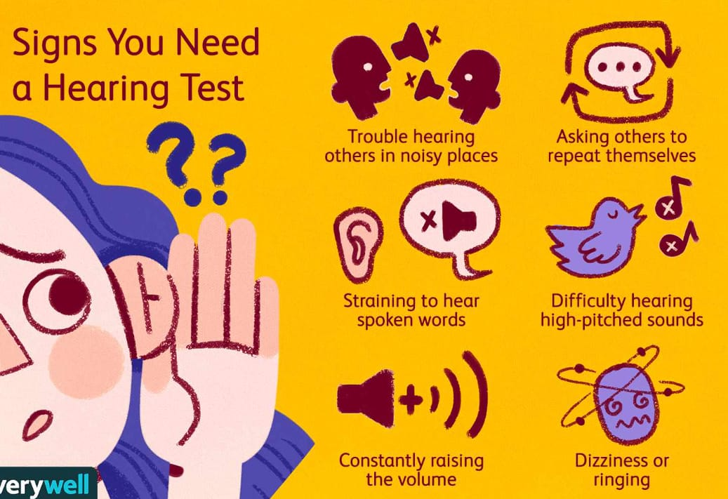
INTRODUCTION TO TYPES OF AUDITORY DISABILITIES
Notes:
hearing impairment is the inability of an individual to hear sounds adequately. This may be due to improper development, damage or disease to any part of the hearing mechanism. Hearing is a prerequisite for the development of normal speech & language. It is an invisible impairment. Keen observation is necessary to identify a deaf child/individual. Deafness at birth or in early childhood has disastrous effects on the child's overall development. These effects vary depending upon the age of onset, nature, and degree of hearing impairment.

Slide 3
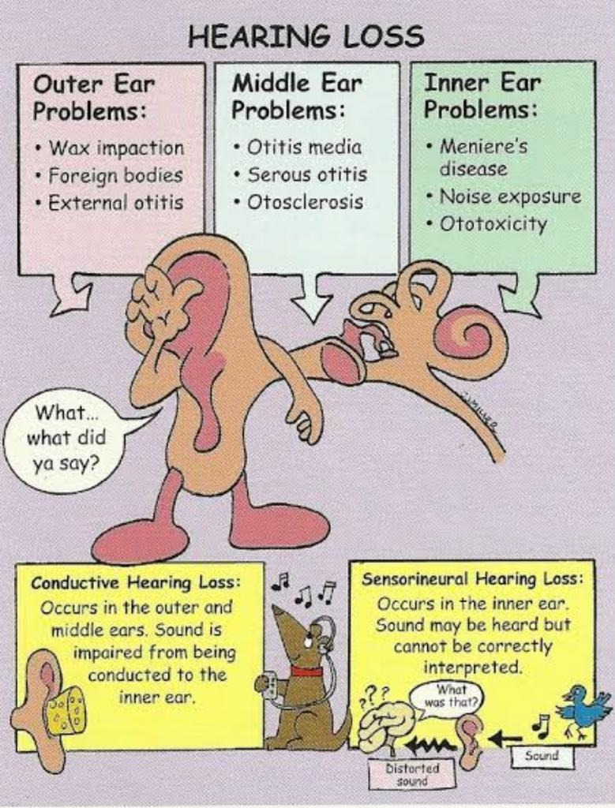
1 . HEARING LOSS
Notes:
Our ear is made up of three parts— the outer, the middle and the inner ear.
A conductive hearing loss happens when sounds cannot get through the outer and middle ear. It may be hard to hear soft sounds. Louder sounds may be muffled. Medicine or surgery can often fix this type of hearing loss.
A sensorineural hearing loss, or SNHL, happens after inner ear damage. Problems with the nerve pathways from your inner ear to your brain can cause SNHL. Soft sounds may be hard to hear. Even louder sounds may be unclear or may sound muffled. This is the most common type of permanent hearing loss. Most of the time, medicine or surgery cannot fix SNHL. Hearing aids may help in hearing.
Sometimes, a conductive hearing loss happens at the same time as a sensorineural hearing loss, or SNHL. This means that there may be damage in the outer or middle ear and in the inner ear or nerve pathway to the brain. This is a mixed hearing loss.Anything that causes a conductive hearing loss or SNHL can lead to a mixed hearing loss.

Slide 4
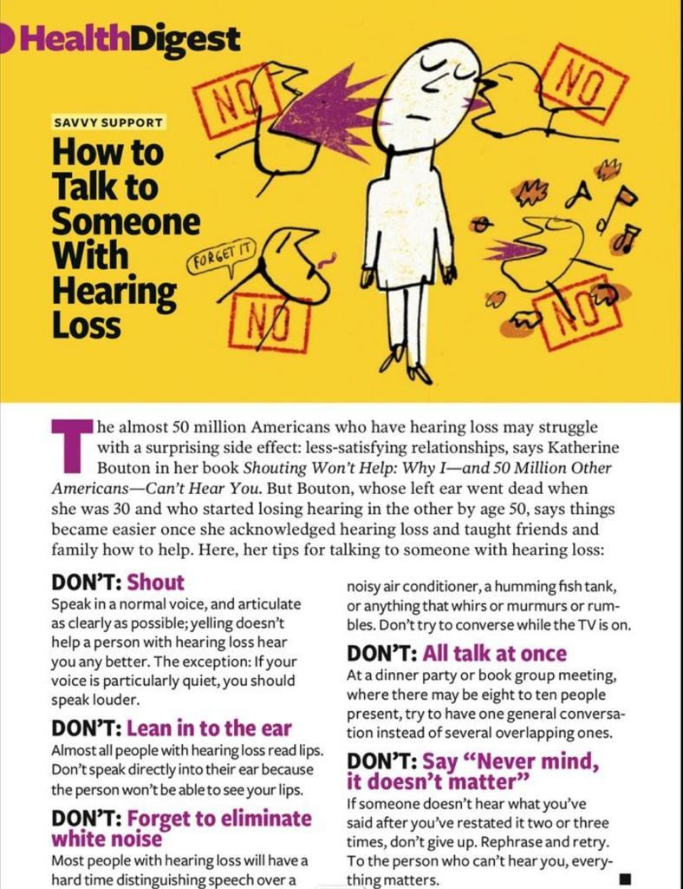
2. HEARING IMPAIRMENT
Notes:
How to talk to people with hearing impairment?
Don’t shout.
Face the person and talk clearly.
Give facial expressions to provide clues.
If the person can’t hunderstand try to repeat using different words.
Be patient and don’t talk all at once.

Slide 5
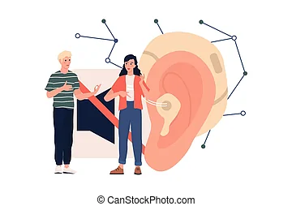

MISCONCEPTIONS IN HEARING IMPAIRMENT
Notes:
Misconceptions about people with hearing loss are commonplace – some are antiquated stereotypes, while others just incorrect assumptions. It’s easy enough to get the wrong idea, as hearing loss can be an invisible disability – unlike the wheelchair that signals a mobility challenge

Slide 6
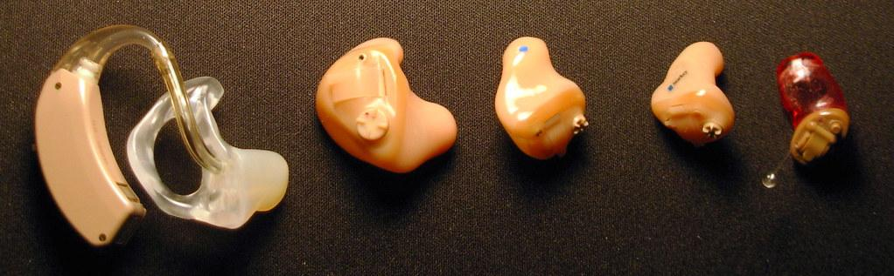
MISCONCEPTIONS IN HEARING IMPAIRMENT

Slide 7
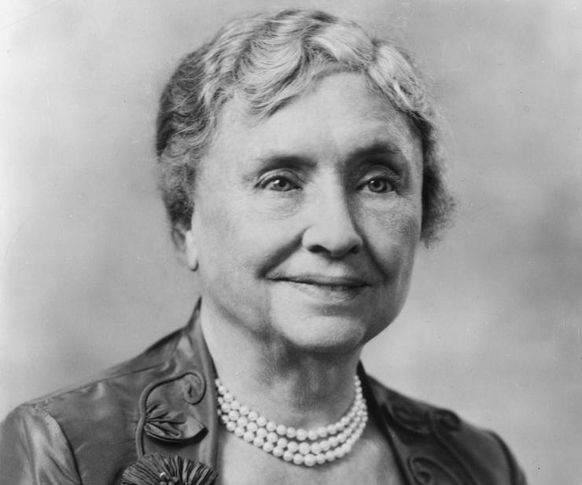
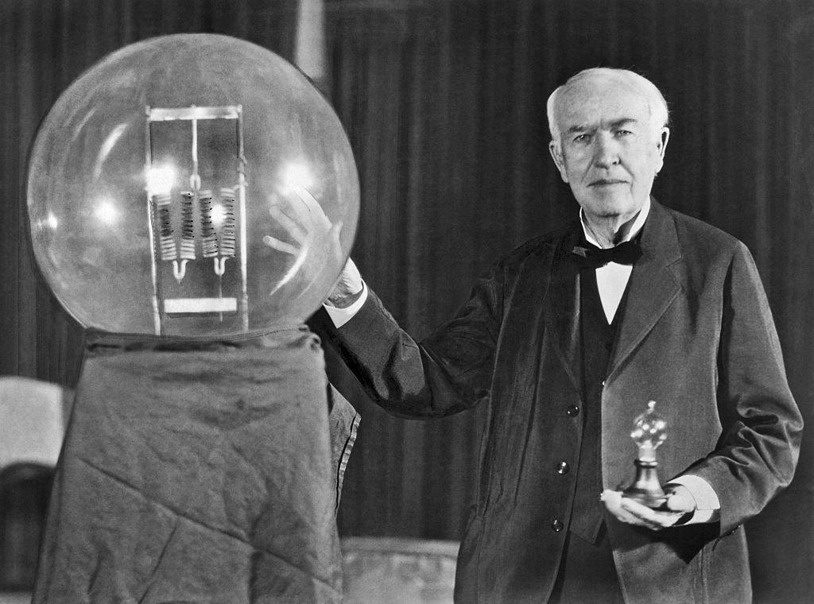
PEOPLE WHO OVERCAME HEARING IMPAIRMENT
HELEN ADAMS KELLER
THOMAS EDISON

Slide 8

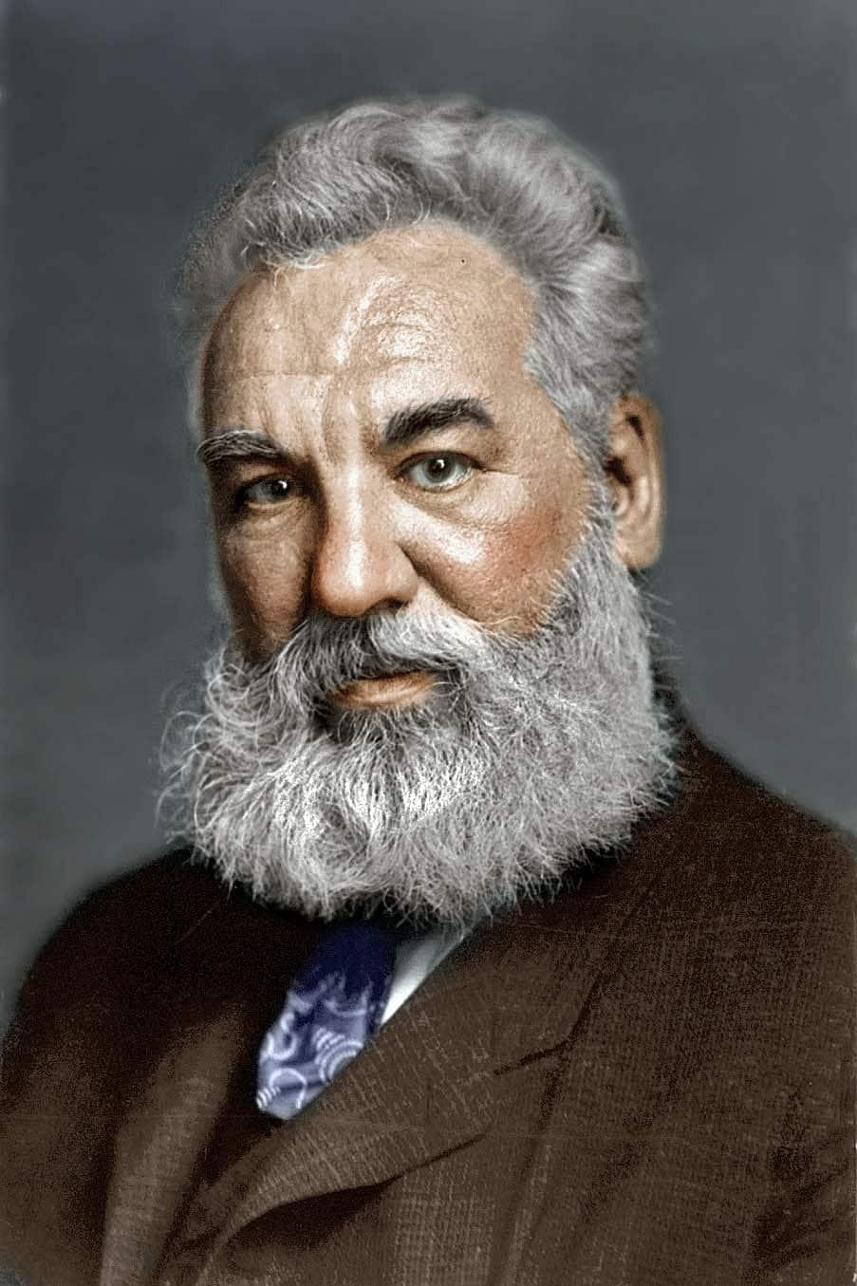
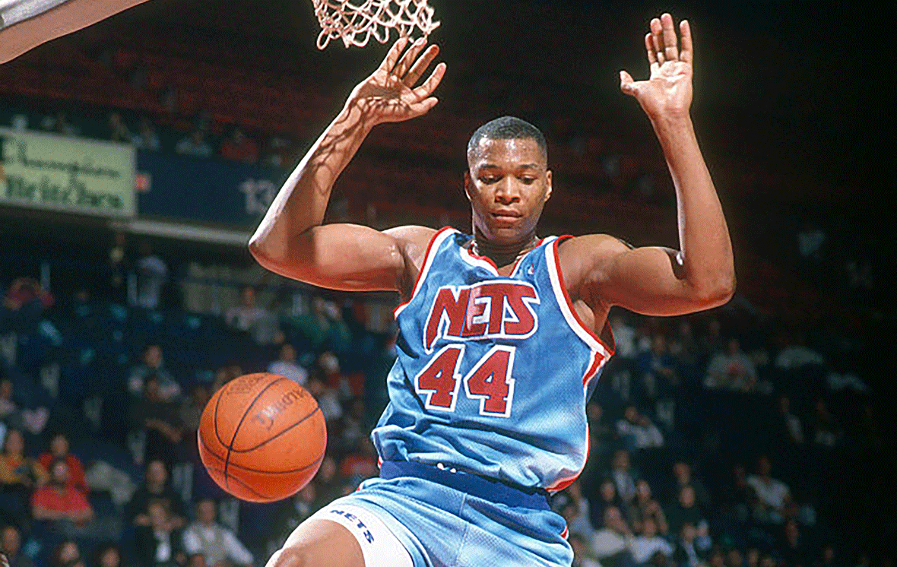
OTHER PEOPLE WHO ARE BATTLING OR HAVE OVERCOME HEARING IMPAIRMENT
MILLIE BOBBY BROWN
ALEXANDER GRAHAM BELL
DERRICK COLEMAN

Slide 9




INCORRECT DEPICTION OF HEARING IMPAIRMENT IN MODERN LITERATURE AND MOVIES
Notes:
For a long time, hearing impairment has been showcased incorrectly in movies and literature. It has been portrayed in ways that have caused hurt to the community as it has been represented as greatly exaggerated and incorrect and even to add comedy. For example, movies like Sound of Metal and Barfi were aimed towards educating people on the issue, but THEY failed to achieve that since there were numerous inaccuracies throughout both films. In movies like feel the beat and ABCD 2, the deaf character seems to play the token character to represent an entire community. These movies do not have a malicious motive but their message just doesn’t reach the audience thus negatively impacting the deaf community.

Slide 10




PROGRESSIVE DEPICTION OF HEARING IMPAIRMENT IN MODERN LITERATURE AND MOVIES
Notes:
But with growing awareness on the issues there has been a significantly positive change in how the entertainment industry views and depicts hearing loss. Hearing impairment is being normalised today, without being trivialized by movies and books that help promote the message. The series CODA is a heart touching story that has been applauded for the awareness it has brought. Marvel’s Hawkeye is another huge hit, not only in the theatres but also because the main character going through hearing loss has helped the community feel represented. Books like WonderStruck and Maybe Someday take a fresh approach on hearing impairment, where the authors have not reduced the characters to just people with hearing loss. Although there is still scope for improvement when it comes to representation of hearing loss, these movies and books are an indication that change can be created in the first place.

Slide 11
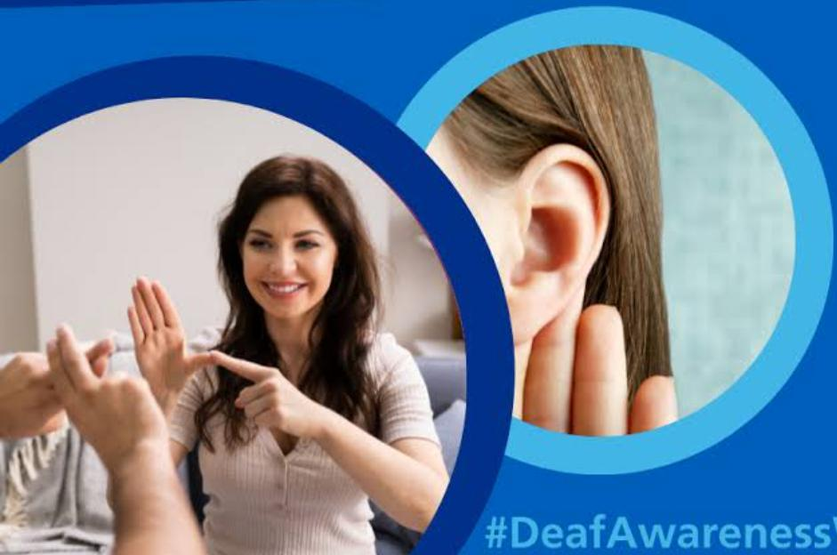

HOW TO SUPPORT SOMEONE SUFFERING FROM HEARING IMPAIRMENT
Notes:
It's well known—and maybe you've experienced it—that hearing loss can put a strain on relationships, causing stress, hurt feelings and frustration over miscommunication. If you sometimes get frustrated, one good thing to do is learn more about what hearing loss is like.
When someone has hearing loss, oral communication, a vital function of participating in society and relationships, is negatively affected. But remember, effective communication goes far beyond spoken words. Gestures and facial expressions enhance the meaning of the message.
Whenever possible, face the person when talking, keep your mouth uncovered and gently get his or her attention before beginning a conversation. Do not chew gum while talking because it distorts the shape of your mouth making lipreading more difficult. Your friend may have extra difficulty hearing when he or she is stressed, tired, upset or sick. Be flexible in having conversations until there's a better time.
For example, it can be especially difficult for a person with hearing loss to hear in group situations, whether it's at a dinner or party, due to the background noise. Before a family gathering, you can call or email the other relatives to let them know some tips and tactics to help foster more successful communication with the family member with hearing loss. At dinner, you can make sure to sit next to that person and let him or her know that if a punch line is missed, he or she can turn to you to get the missed information.

Slide 12
Credits
Syna Gupta
Amiya Seth
Shreena Gulati
Manya Kohli
Prangaya Gupta

